Slide 1

DriverPass System Analysis
Jaden B. Knutson
Notes:
[No speaker notes required for this slide.]

Slide 2

System Requirements
List at least two functional requirements and two nonfunctional requirements.
Functional:
Reservation System
Driver / Student matching
Nonfunctional:
Accessibility
Security
Notes:
SLIDE 1:
FUNCTIONAL REQUIREMENTS
Reservation System: The system will allow customers to make, cancel, and modify reservations for driving lessons to include the date and time.
Driver Matching: The system will track and match drivers to customers. It will also indicate the time of the lesson and the car being used.
NONFUNCTIOINCAL REQUIREMENTS:
Accessibility: The system will be accessible from any computer or mobile device . This will allow the Admin to download reports and other information for needed offline purposes.
Security: Each employee will have different roles and rights within the system. The system will monitor employee activity with printable activity reports.
SPEAKER NOTE
The functional requirements selected are based on the core operations of DriverPass.
The management of the reservation system and matching of drivers to students are two areas developed to meet the user’s needs.
The system will allow customers to make, cancel, and modify reservations for driving lessons to include date and time.
The systems will also track and match drivers to customers to include the time of the lesson and the car being used.
The non-functional requirements of accessibility and security were prioritized .
For maximum accessibility, the system is able to be ran on most modern devices that can run an internet browser. This will allow for more people to be able to interact with and use our system.
By clearly defining the roles and needs of the systems users, select features and options are programmed to meet the needs of each user.
These roles allow for better security risk management by designating the abilities based on the user roles.
For instance, the Owner’s position warrants the ability to access data both on and offline.
This role was taken into consideration during program development with the Owner having the ability to download, save, and print reports.
While this is helpful for the owner, this information could potentially be dangerous in the hands of others.
Each user role within the DriverPass program was carefully analyzed with the needs or each user incorporated into system development.
The system will monitor each employee activity to keep track of mistakes or errors.

Slide 3
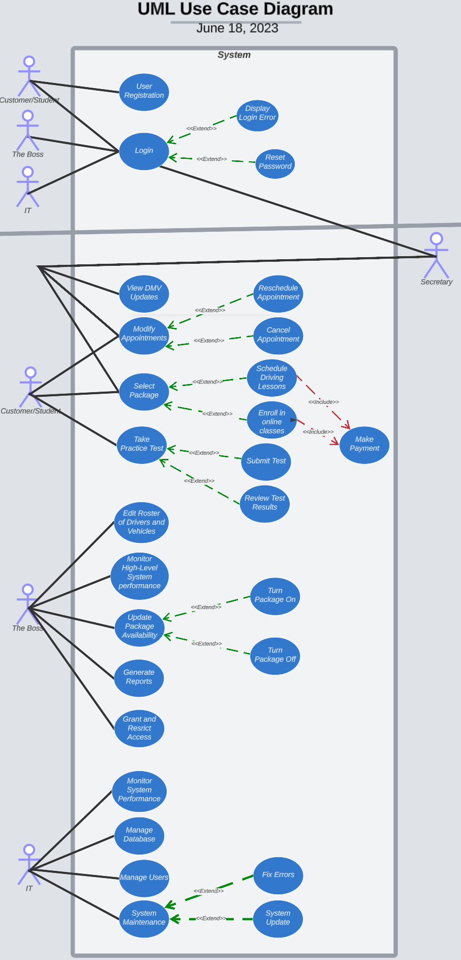
Use Case Diagram
-
Notes:
SLIDE 2: Use Case Diagram SPEAKER NOTES:
As mentioned earlier, the roles of the DriverPass program were analyzed to promote role differentiation, while addressing role interaction for a smooth flow of input, information processing, and output.
The users in the DriverPass system are the Owner, IT, the secretary, and the customers.
With the distinct roles incorporated into the system, each user is able to achieve and perform role related objectives.
For instance, customers make, cancel, or modify their own reservations, while the secretary schedules and modifies appointments for others.
The IT officer oversees and maintains the system while the admin accesses reports, monitors activity, and updates the employee and car database entries.

Slide 4
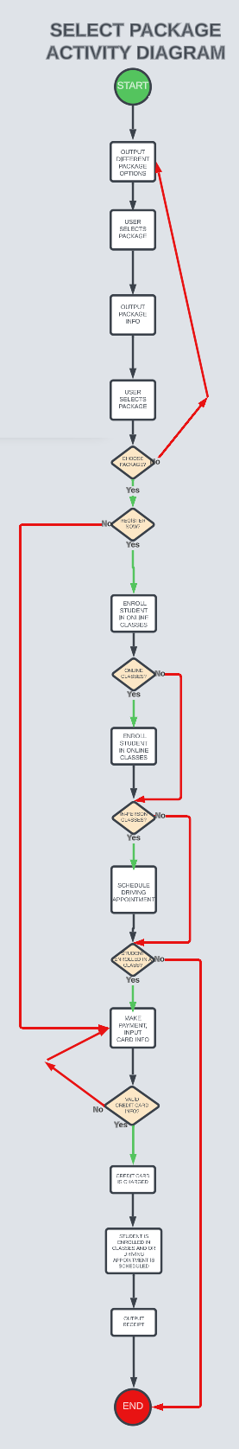
Activity Diagram
-
Notes:
SLIDE 3: Activity Diagram SPEAKER NOTES:
Complicated customer interfaces often result in confused customers and/or lost sales .
The DriverPass program focuses on easy, step-by-step instructions that promotes understanding.
For our purposes, let’s go through the customer process of selecting a driving package.
The steps involve the customer reviewing the package options, choosing a package, and registering.
The customer has a choice to register at that moment, or they can pay now and do it later.
If the customer wishes to signup now, the program will lead the customer to the online or in-person class registration.
If an in-person class is selected, a driving appointment will be selected. If an online course is selected , the customer is taken to class enrollment.
Once that step is decided on, the system will take the customer to payment processing.
Provided a valid credit card submission, the customer officially is enrolled in the system, making any reservations and appointments valid in the system.
The DriverPass design prioritizes simplicity and intuitiveness, taking the customer seamlessly through the selection process in a user-friendly and efficient manner.

Slide 5
Security
Include a bulleted list of how your design addresses security concerns.
Login security and verification.
Role-Based Security and Access
Activity Tracking for all users
Notes:
SLIDE 4: Security Considerations
Role-based access: Different employees have different rights and roles to ensure only authorized personnel can access certain information.
Activity tracking: The system tracks who made a reservation, who canceled it, and who last modified it, providing accountability and traceability.
SPEAKER NOTES:
In Our design, we considered security at every stage.
We implemented role-based access to ensure only authorized personnel perform certain actions.
We have incorporated multiple steps of verification from login all the way to credit card information verification with the banks.
We also incorporate mini securities such as captchas or locking someone out of their account if they enter the wrong password too many times.
This will also result in a notification email sent to the user indicating multiple wrong password attempts have been attempted.
We included a comprehensive activity tracking system amongst our users and employees to ensure accountability and traceability.
This will be important especially if something goes wrong.

Slide 6
System Limitations
Include a bulleted list describing the limitations of your system.
Internet access and electricity required to access the system.
The system will need developers for adding new packages.
No reminder system for text or email.
Notes:
SLIDE 5: Limitations
The system requires online access for most functionalities, including data modification and updates, which may limit its usability in areas with poor internet connectivity.
The system does not automatically adjust to fluctuations in demand, which may result in overbooking or underutilization of resources.
SPEAKER NOTES:
While our design addresses many of DriverPass's needs, it does have some limitations:
Internet access is required for most functionalities, which could be a challenge in areas with limited connectivity.
The system does not have an appointment or class reminder system set-up for text or e-mail generation.
Such a system would promote decreased missed visits and last-minute cancellations.

